Slide 1
Building your digital toolbox
Mike Feagans
@mfeagans33
Mike.feagans@rcsc.k12.in.us

Slide 2
Thoughts:
•giving students more freedom to explore on their own and problem solve.
The “WHY?” factor
•Apps and web sites -- learning to keep up with every changing world of technology
•learning to be patient and not over load them with to much, but allowing them to see how these aspects
of technology can help them.

Slide 3
Lightning Round
Student’s Engagement
Coveritlive.com
Todaymeet.com
Charts
Lucidchart
Portfolios/Communication
Livebinders.com
Smore.com
Weebly
Symbaloo
Mindmiester
Outside the Box
Explain Everything

Slide 4
Weebly.com
Free web site
Easy to use
Create pages with blogs, documents, videos, etc

Slide 5
http://feagans.weebly.com/
Web site
Blog
Symbaloo

Slide 6
WWW.SYMBALOOEDU.COM
Access your bookmarks anywhere with Symbaloo.
Symbaloo is the easiest way to start on the internet
Discover pages with the best links about a subject;
Create your own pages with favorites;
Share your page with the rest of the world.
Share projects
being presented
sharing, my assignments, videos, etc.
click on a tile and not have to worry about them typing in the wrong address.

Slide 7
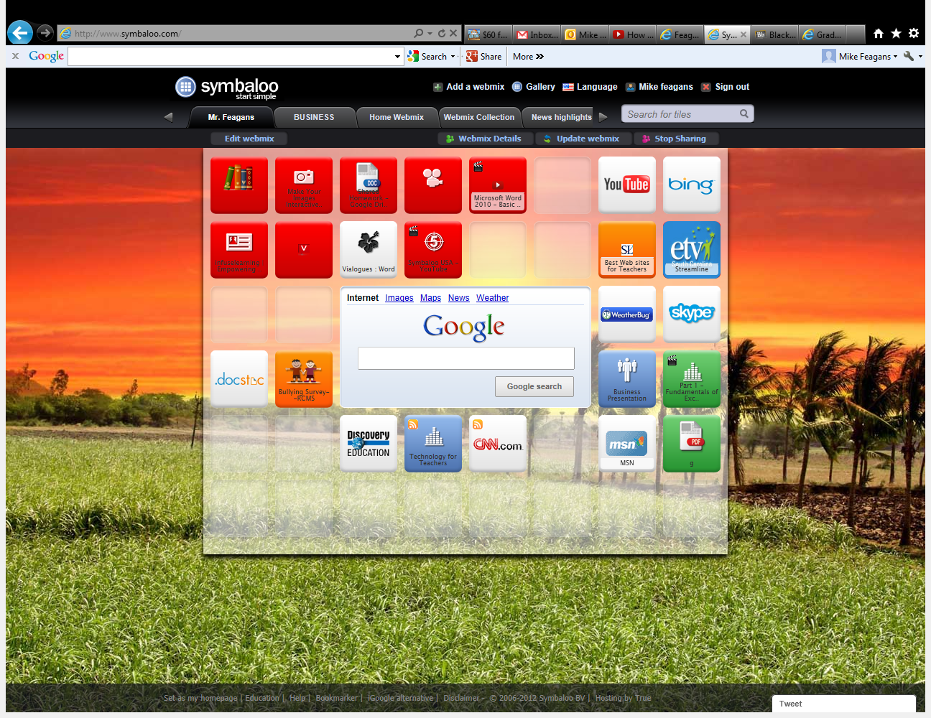
Double-click to enter title
Double-click to enter text

Slide 8
Livebinders.com
3 ring Binder for the web
Collect your resources
Organize them neatly and easily
Make an impression

Slide 9
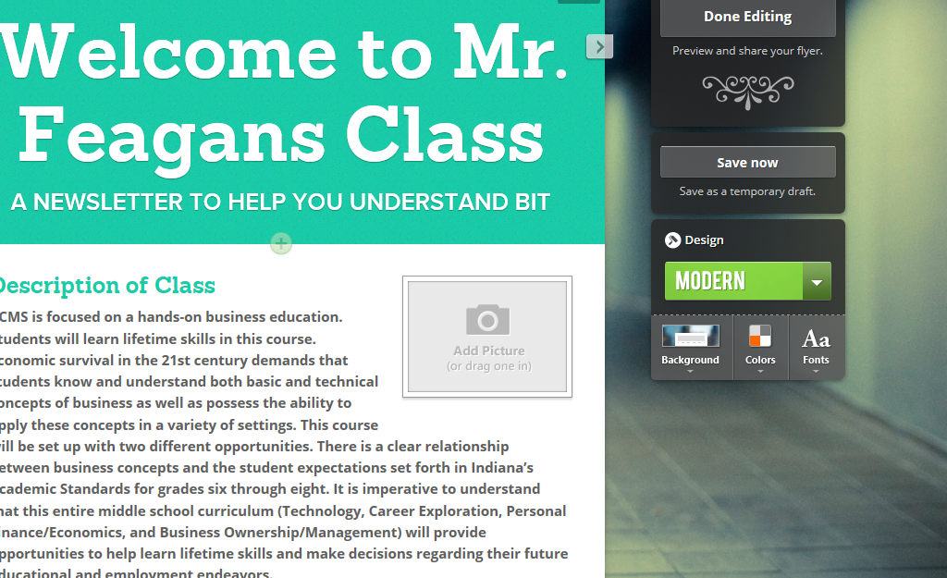
Smore.com
Create beautiful flyers and newsletters

Slide 10
http://www.mindmeister.com/
A great brainstorming tool
Create, view, and edit Mind maps

Slide 11
Goanimate.com
Great way to make videos and let the kids to be creative and active in learning.
www.goanimate.com

Slide 12
Coveritlive.com
Open Blog for live engagement
You control which posts are shown
Keeps students commenting and paying attention
Today’s meet
https://todaysmeet.com/

Slide 13
Lightning Round
Getkahoot.com
Blendspace.com
Smore.com
Goanimate.com
QR codes and Au
OER’s

Slide 14
https://getkahoot.com
A GAME-BASED CLASSROOM RESPONSE SYSTEM
FOR SCHOOLS, UNIVERSITIES, & BUSINESSES
ASK THOUGHT PROVOKING QUESTIONS
Which motivate participation through game-based learning and rewards in a social setting.
STUDENTS, TAKE CONTROL OF YOUR OWN LEARNING
Through research and creation you inquire with meaningful questions, turning you in to a leader.
EASY-TO-USE, INCLUSIVE & HIGHLY ENGAGING
Backed by academic research in blended learning. Using technology in your classroom will never be the same again.

Slide 15
Snacktools
CREATE, IMPROVE & PROMOTE WEBSITES
High-quality banners, widgets and websites, the Snack way
http://www.snacktools.com/en/

Slide 16
Quizlet.com
Make Flash Cards
Quizzes
Vocabulary Lists

Slide 17
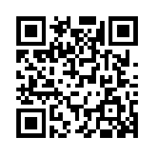
QR CODES
QRSTUFF.COM
Making a QR code for web sites, presentations, documents, videos, etc.

Slide 18
Aurasma
Great app!
Aurasma allows users to engage in and create Reality experiences of their own. Educators and (more importantly) students can use this open source tool to essentially bring their learning to life.
From Edutopia article

Slide 19
